Slide 1


Predicting Customer Churn at SyriaTel Company
By
SHARON .L. Aoko
10-06-2025

Slide 2

Project Overview
This project focuses on customer churn (the loss of subscribers), which is a critical challenge for telecom companies like SyriaTel, directly impacting revenue and growth.
With increasing competition, companies need targeted retention strategies to save significant costs compared to acquiring new customers
The main stakeholders of this project is are SyriaTel’s Customer Retention Team

Slide 3

Project OUTLINE
These are the areas that will be highlighted in this presentation:
Business Problem
Objectives
Modeling and Evaluation
Conclusion
Recommendations

Slide 4
Problem Statement & Dataset overview
Dataset Overview
The dataset is in csv format, it has 3,333 rows of customers’ data
It contains the following fields:
Account info: state, account length, area code
Usage metrics: total day minutes, international calls, number of customer service calls
Plan details: international plan (yes/no), voice mail plan
Main target is: churn (True/False)
Syriatel is a private mobile provider based in Syria. They would like to predict whether a customer will soon unsubscribe or stop doing business with them. This project focuses on customer churn, which is a critical challenge for telecom companies as it directly impacts the revenue and growth of such companies. With increasing competition, companies need targeted retention strategies to save significant costs compared to acquiring new customers.
The main problem is the reduction of how much money will be lost because of customers who don't stick around very long, thus leading to lost revenue

Slide 5
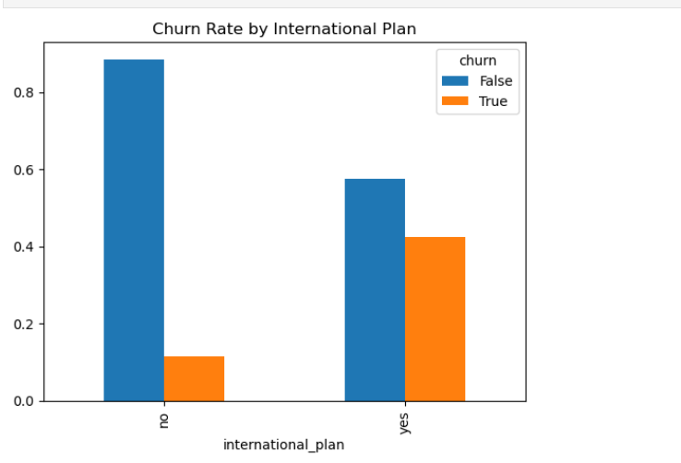
Objectives
The main objective is to develop a predictive model that identifies SyriaTel customers at high risk of churning, enabling proactive retention strategies to reduce revenue loss.
The key questions focus on this analysis are :
1. To predict which customers are most likely to churn using machine learning
2. Identify what the key factors are driving churn, such as service calls or international plans, from the dataset
3. Identify the recommended actionable strategies to retain high-risk customers

Slide 6
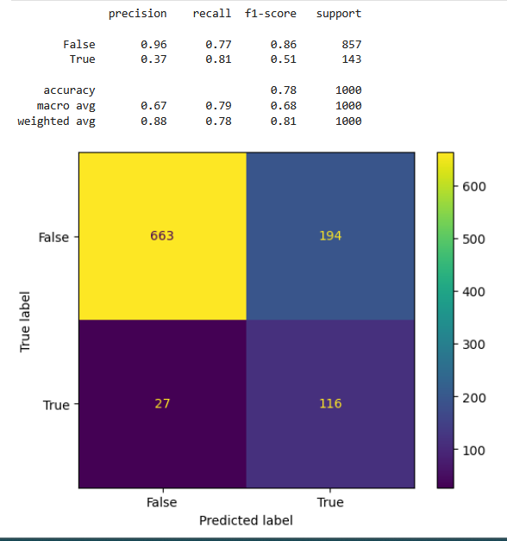
Logistic Regression Modeling and evaluation
For "Not Churn" Customers (False):
96% Precision: When the model says a customer won’t leave, it’s correct 96% of the time.
77% Recall: the model misses 23% of loyal customers that means it wrongly flags them as "about to leave".
For "Will Churn" Customers (True):
37% Precision: When it predicts a customer will leave, it’s wrong 63% of the time.
81% Recall: the model catches 81% of actual churners this is good, but with many false alarms.

Slide 7
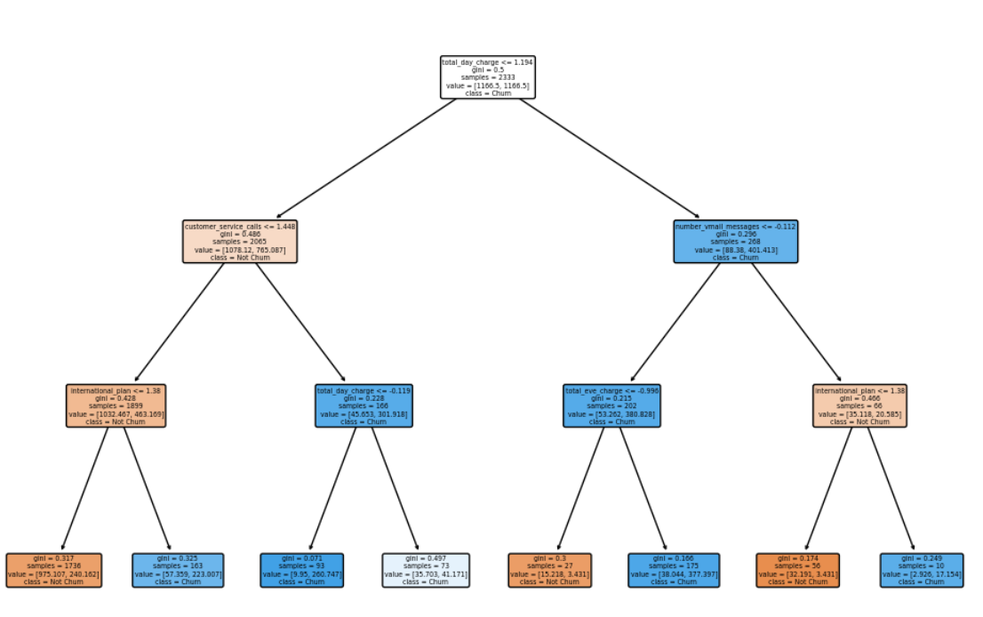
Decision Tree Modeling and evaluation
From the decision tree above we identified the top 3 drivers of customer churn in your telecom dataset:
International Plan (32.5% impact)
Customers with international plans are 3× more likely to churn.
Action: Stakeholder need to review international plan pricing/quality. Offer targeted retention deals.
Customer Service Calls (32.2% impact)
Each additional service call increases churn risk dramatically. Action: The stakeholder needs to improve first-call resolution. Flag customers who make ≥3 calls.
3. Daytime Charge (27.2% impact)
High daytime charges correlate with churn.
Action: The stakeholder needs to analyze if competitors offer better daytime rates.

Slide 8
CONCLUSION
From the analysis done for SyriaTel’s Customer Retention Team, the model predicted that:
For International Plan Users:
Higher entropy means they're harder to predict
They need more nuanced retention strategies
For Domestic-Only Users:
Lower entropy makes them easier to manage
They need standard retention offers that may work well
For Feature Priorities:
They should Focus on high-information-gain features first that is international_plan → customer_service_calls → total_day_charge

Slide 9
RECOMMENDATIONS
From the analysis done the model gives a prediction of the likelihood of the customers to leave if:
They have an international plan.
They Called customer service 3+ times
Have high daytime charges
Due to this limitations, the stakeholders should Prioritize retention offers such as discounts, special perks for these customers.
They could also train support teams to handle international plan issues better.
The stakeholders should not focus on features such as Night/weekend call usage, how long they’ve had the account and whether they have voicemail

Slide 10

NEXT STEPS
Share the high-risk customer list with the retention team.
Meet with support team to address international plan issues.
Schedule a 3-month review with the data analyst team

Slide 11

THANK YOU Sharon .L. Aoko sharon.aoko@student.moringaschool.com

